Slide 1
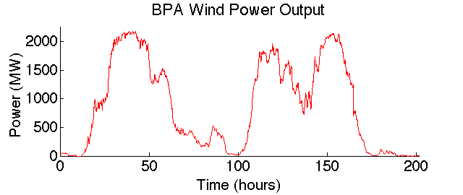
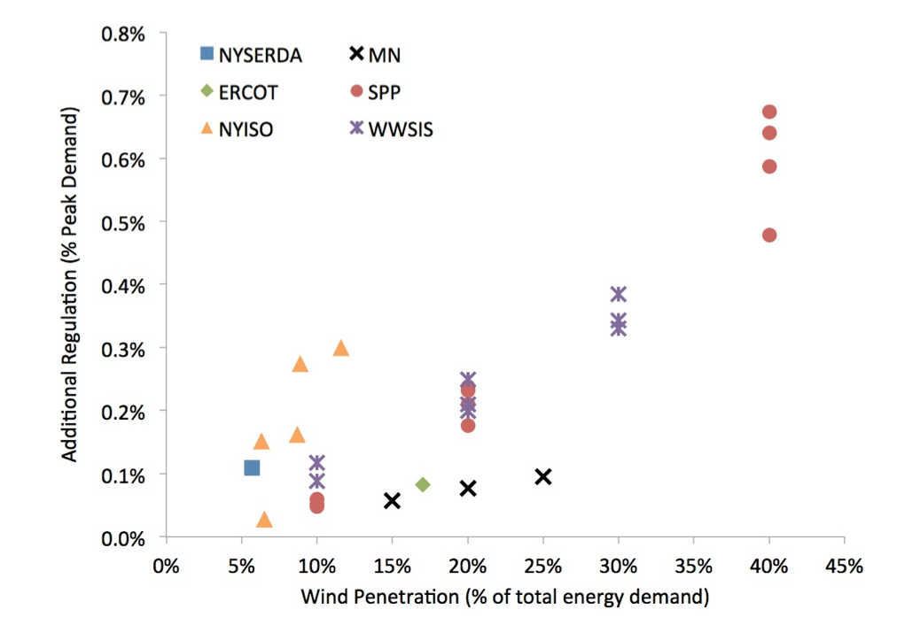
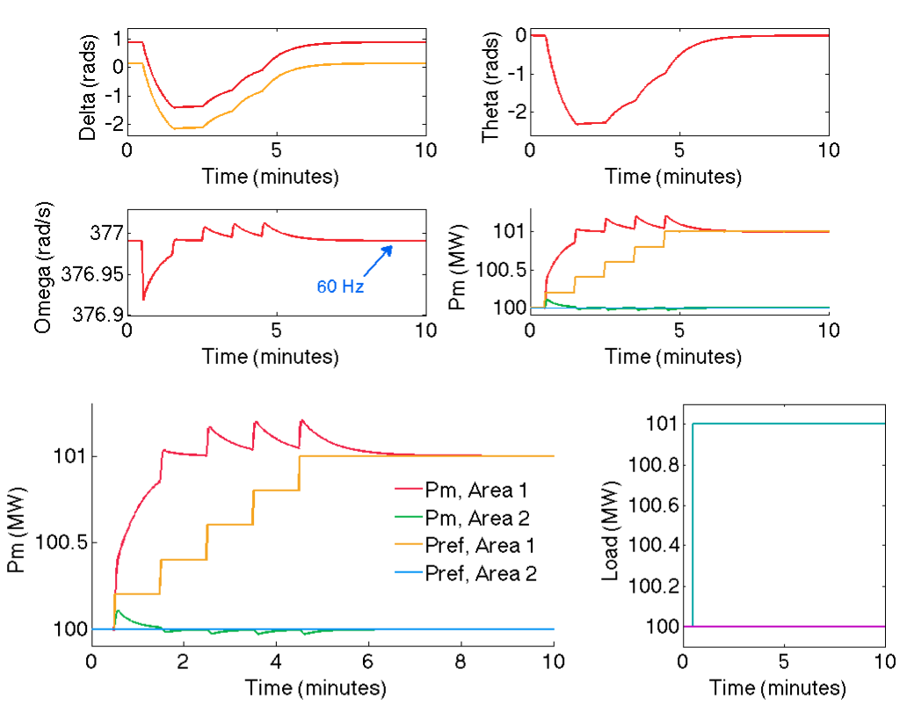
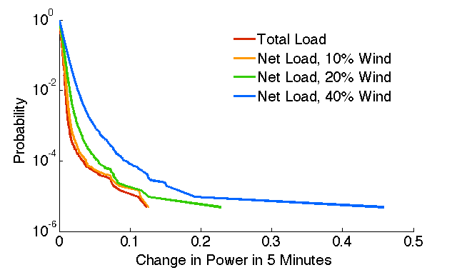
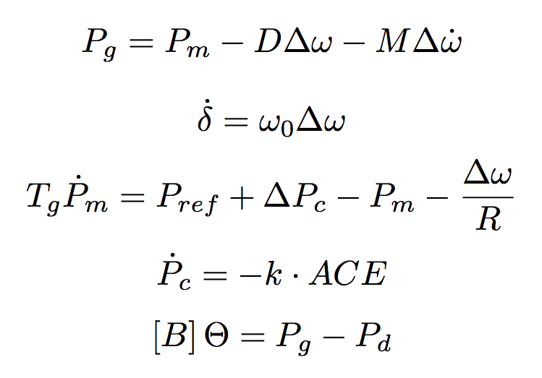
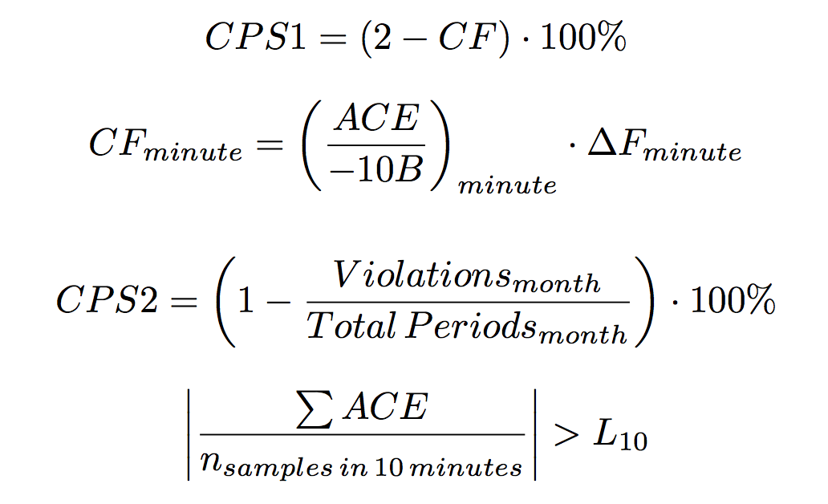
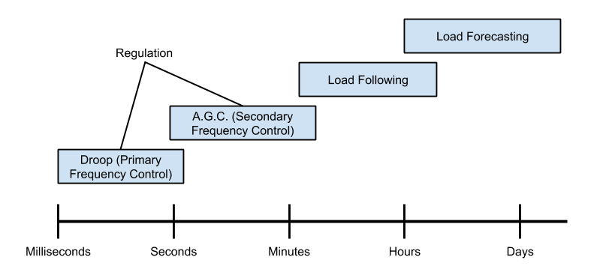
Quantification of the Impact of Renewable Penetration Levels on Power Grid Stability Libby Kirby Advisor: Dr. Paul Hines, Ph.D
Problem Statement
The impact of intermittent renewable generation on the power grid is of significant concern to utilities. Utilities must know the amount of backup generation (“regulation”) needed to maintain adequate system performance amid this intermittency. Our research goals are to
Quantify the amount of regulation needed to maintain stability for varying wind penetration levels
Identify how this quantity is influenced by
Dispatch time
Consolidation of balancing area
Amount of inertia
Dynamic Simulation:
Recently published wind studies aiming to quantify the necessary regulation tend have two main issues:
Limited Data Points: Most studies consider only 3-4 wind penetration levels, making it difficult to predict the general trend
Lack of Dynamic Simulation: Most studies rely on statistical inference of wind data to predict the necessary regulation, usually using 5 minute wind data at the highest resolution. However, this misses any performance issues on a sub-5 minute scale. Considering the intermittency of wind at sub-5 minute time scales, we expect to see performances effects on this scale, and thus instead employ a dynamic simulation model, which captures the second-to-second effects on performance.
Variability:
While load already presents some intermittency (the current use for regulation), increasing wind penetration level increases the overall variability of the net load (load-wind).
One/week
Swing Equation: Physical Model of Generator
Quantification of Frequency Performance:
Utility Control of Variability:
Droop Control
Automatic Generation Control (A.G.C.)
Algebraic Equations: Power Injection
Notes:
ED?
Make CPS1 one eqn and CPS2 1eqn?
Numerical int figs?
Find paul’s nice figure matlab function

